Slide 1


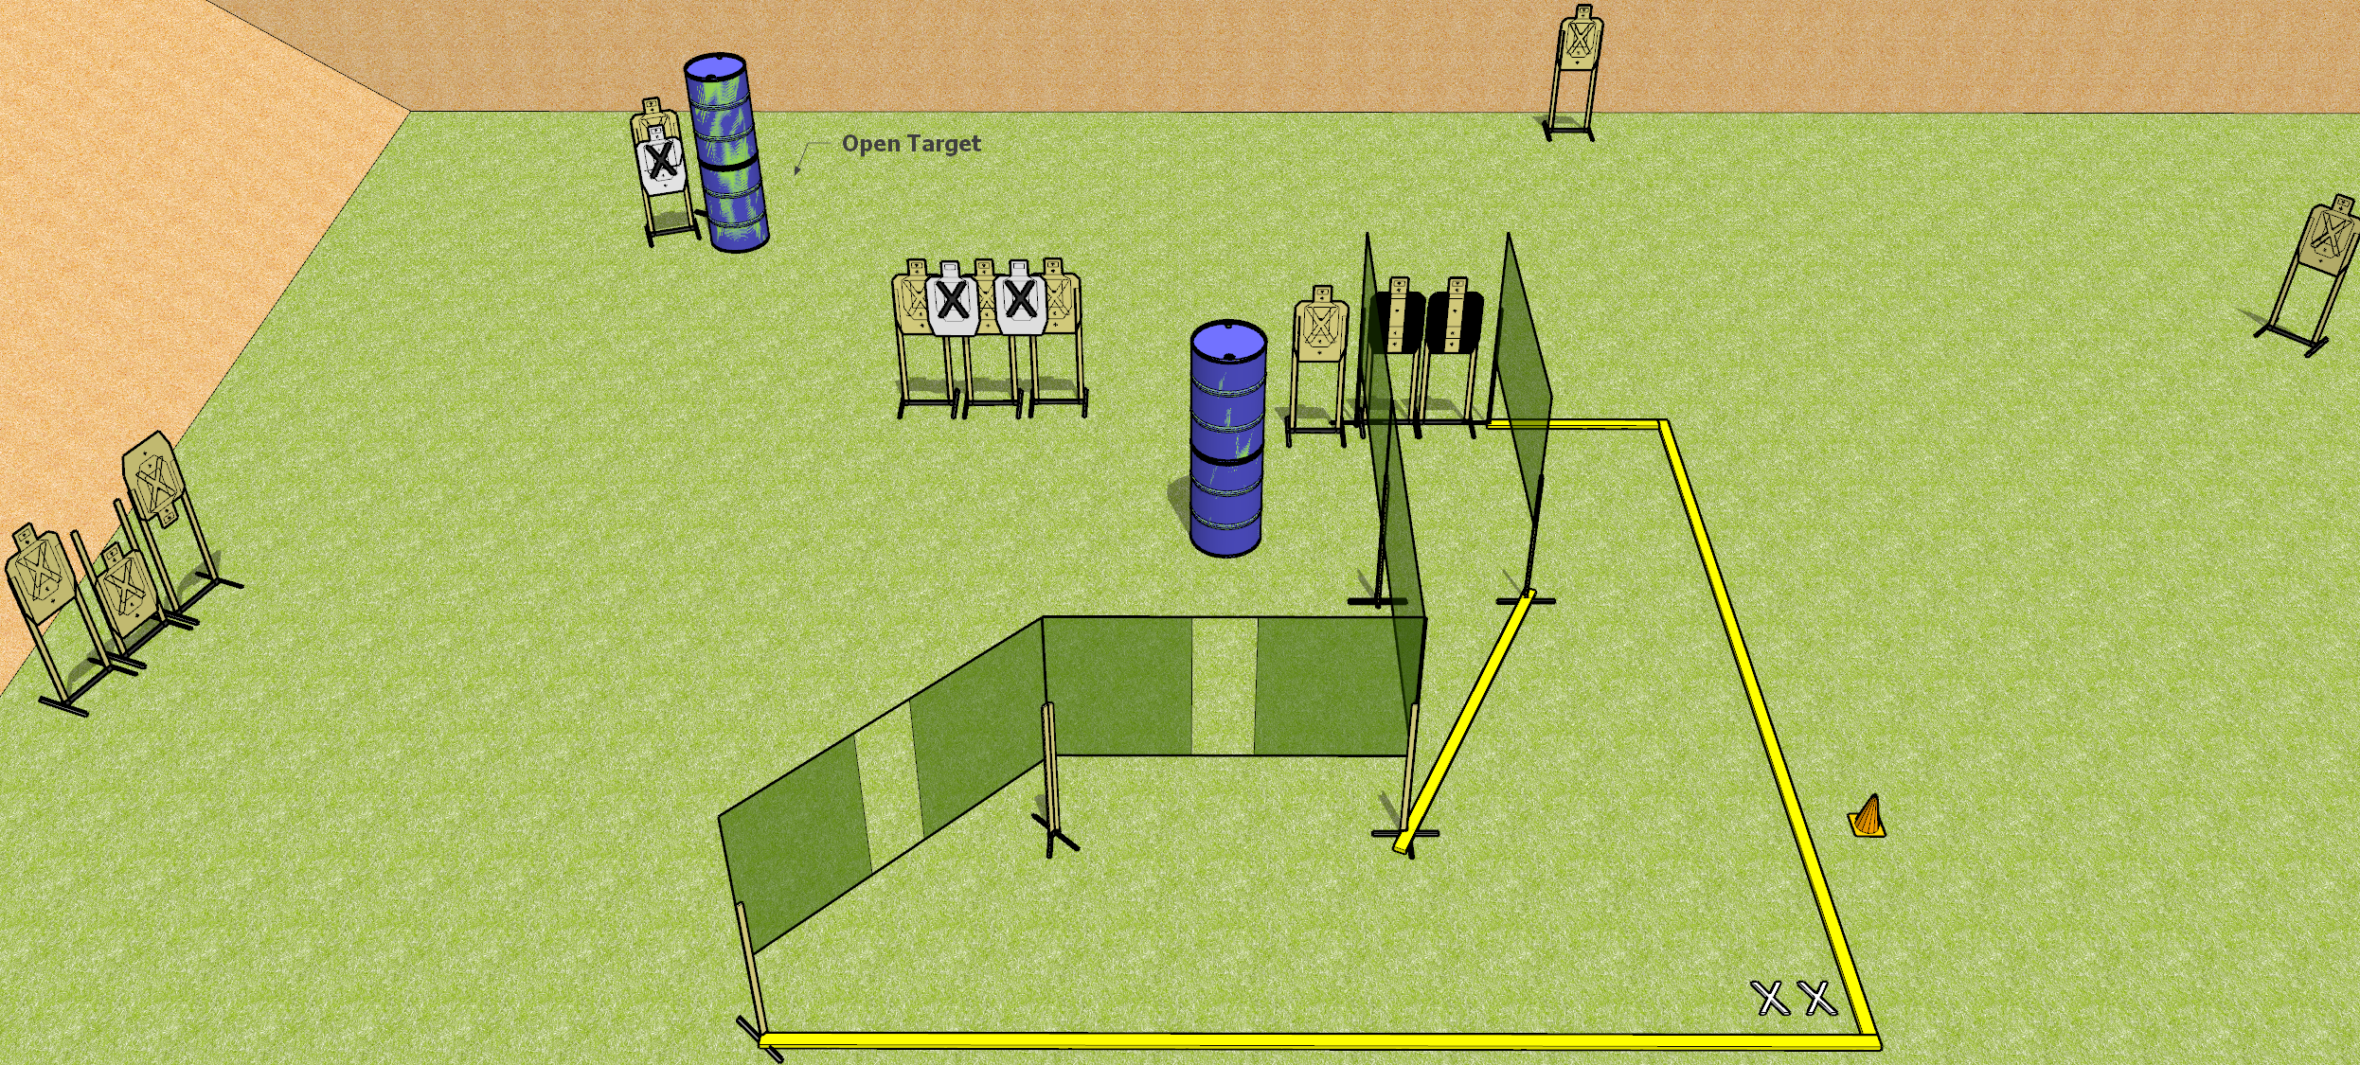
 | Dothan Gun Club – USPSA Match Fire Hose Course Designer : Drew Coleman
START POSITION : Standing with both feet covering X’s, wrists below belt
GUN READY CONDITION : Pistol loaded and holstered. PCC loaded, shouldered, safety on, pointed at orange cone. |  | SCORING: Comstock, 26 rounds TARGETS: 13 paper, 0 Steel SCORED HITS: Best 2 on paper, steel until down START-STOP: Audible, last shot RULES:
STAGE PROCEDURE: Engage targets as they become available from within the fault lines.

Slide 2
Fire Hose
Written Stage Briefing
Fire Hose is a 26 round, 130 point, Comstock Field Course. There are thirteen USPSA targets. The best two hits per target will score. The start signal is audible.
Handgun start position is feet covering X’s, wrists below belt. Handgun is loaded and holstered
PCC start position is feet covering X’s, loaded carbine held in both hands, safety on, shouldered, muzzle pointing at cone.
Upon start signal, engage targets as they become available from within the shooting area.

